Slide 1


Title: Profit and Loss
EQ – How can we express Profit & Loss as a %?
Review from last lesson
A furniture shop was having a 20% off sale on all chairs. Ms. Latham picked out a chair that was originally worth $40, how much did she pay for the chair?
Mr. Summers was visiting Canada and had dinner at a restaurant that cost him $30 and he needed to add an 18% tip, how much did he have to pay altogether?

Slide 2

24
7
30
Date
Title: Profit and Loss
EQ – How can we express Profit & Loss as a %?
What is profit & loss?
if you make money by selling an item for more than you bought it for than you make a Profit, if you loose money by selling an item for less than you bought it for it is a Loss
You can express the Profit or Loss to the SP or the CP
Selling price – how much the item is sold for
Cost price – how much the item was originally bought for
What are we comparing to?
How to calculate the % Profit ?
Profit = selling price - cost price
$$\% Profit= \frac{Profit}{price you are comparing to }×100$$
5

Slide 3
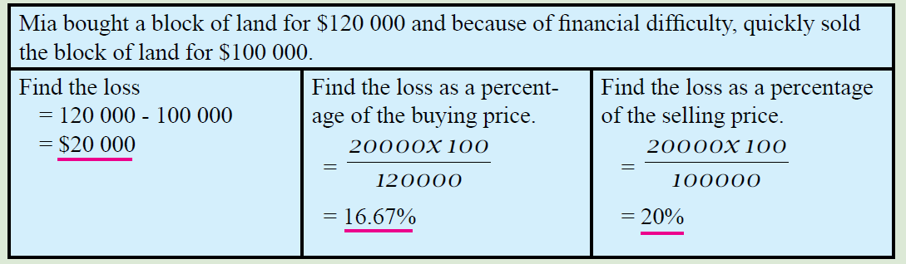


24
7
30
Date
Title: Profit and Loss
EQ – How can we express Profit & Loss as a %?
How to calculate the % Profit ?
Profit = selling price - cost price
$$\% Profit= \frac{Profit}{price you are comparing to}×100$$
How to calculate the % Loss?
Loss = cost price – selling price
$$\% Loss= \frac{Loss}{price you are comparing to}×100$$
5

Slide 4

Ella bought a 2 bedroom unit 12 years ago for $95 000, and recently sold it for $280 000 (after deducting costs).
1. Did She make a PROFIT or a LOSS?
A profit.
$280 000 is more than $95 000.
$280 000 - $95 000 = $185 000 PROFIT
2. Find the % Profit compared to the Cost Price.
185 000/ 95 000 x 100 = 195 % (% of the CP)
3. Find the % Profit compared to the Selling Price.
$95 000/ 280 000 x 100 = 33.9% (% of SP)
4. Which % profit sounds better for Ella?
(195 % of the BP)

Slide 5
LHS
Try 11.6, p.150
Choose 5 qns to solve with a partner

